Slide 1
HCBS – A.C.T
advocates creating transformation
The New Rules And What That Means For You!
Carlos Espinoza, Self Advocate
Kathy Carmody, CEO, The Institute on Public Policy
Leanne Mull, Quality Enhancement Specialist, CQL
Funded through the Illinois Council on Developmental Disabilities
Notes:
Leanne

Slide 2
The New Rules
What They Mean for You
The new rules list additional conditions that must be met in settings that are owned or controlled by a provider.
Notes:
Leanne
This new rule is a really BIG rule with a lot of little parts to it, isn’t it?! Now we are going to talk about What the rules mean for you!

Slide 3
By any other name!
POCS
POCS =
Provider-Owned or Controlled Setting
CMS calls a CILA a
“Provider Owned or Controlled Setting”
HCBS - A.C.T advocates creating transformation wwww.c-q-l.org/HCBS-ACT
Notes:
Leanne
Explain that Since all of the states have different names for their group homes, CMS (what does that stand for?) decided to come up with their own name.

Slide 4
New CMS Rules for Providers
#1 - Your Lease
There is a legally enforceable agreement
- Sometimes called a LEASE -
…that makes sure you are protected from having to move out of your home in the same way that people without disabilities are protected.
HCBS - A.C.T advocates creating transformation wwww.c-q-l.org/HCBS-ACT
Notes:
Carlos

Slide 5
New CMS Rules for Providers
#2 - Your Privacy
You have the right to privacy in your bedroom if you live with other people or your house/apartment if you live alone.
HCBS - A.C.T advocates creating transformation wwww.c-q-l.org/HCBS-ACT
Notes:
Carlos

Slide 6
New CMS Rules for Providers
#2a. Your Keys
You can lock the door to your bedroom, house or apartment.
You have a key or code to the front door of your home.
HCBS - A.C.T advocates creating transformation wwww.c-q-l.org/HCBS-ACT
Notes:
Carlos

Slide 7
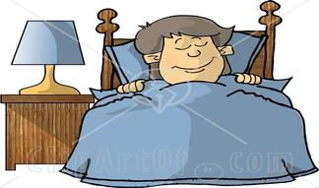
New CMS Regulations
#2b. Choice of Living Arrangements/ Roommate
Do you have a roommate?
Do you want your own room?
Do you have privacy?
Your Independent Service Coordinator and Staff will ASK you about this a lot!! Think about what you want!
HCBS - A.C.T advocates creating transformation wwww.c-q-l.org/HCBS-ACT
Notes:
Carlos

Slide 8
New CMS Rules for Providers
#2c. Your Personal Style
You have the freedom to furnish and decorate your room or house within the limits of the lease or
other agreement.
HCBS - A.C.T advocates creating transformation wwww.c-q-l.org/HCBS-ACT
Notes:
Carlos

Slide 9
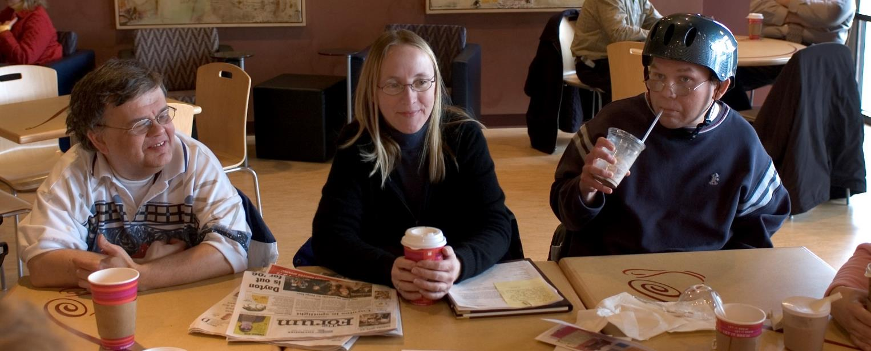
New CMS Rules for Providers
#3. Schedules and Activities
You have freedom and support to control your schedule and activities and have access to food at any time.
HCBS - A.C.T advocates creating transformation wwww.c-q-l.org/HCBS-ACT
Notes:
Carlos

Slide 10
#3a. Control your Schedules and Activities
What does this mean?
You do not have a “bedtime”!
You have access to a TV and can watch TV as late as you want.
You have access to the internet.
Staff support you to do the things you want to do.
You like your schedule of activities and you know how to get assistance with changes if you want.
HCBS - A.C.T advocates creating transformation wwww.c-q-l.org/HCBS-ACT
Notes:
Carlos
Explain that, once again it is not ok for providers to wait until you complain about something to help you with your schedule.

Slide 11
#3a. Access to Food at Any Time
What does this mean?
You have the right to have food and drink when you want it.
HCBS - A.C.T advocates creating transformation wwww.c-q-l.org/HCBS-ACT
Notes:
Carlos
One of the biggest rules is that you have the right to eat what you want when you want it. Now, some of us, like me, like to eat a lot so I have to be careful that I do not overeat or I may get sick. Some people have diabetes or something else that makes them have to be careful about what they eat. Do any of you know someone like that? When that happens we work with our doctor or nurse or friends to help us. But, for most people, it is ok for them to eat and drink what they want. That may not have always happened but now, you will have way more choices.

Slide 12
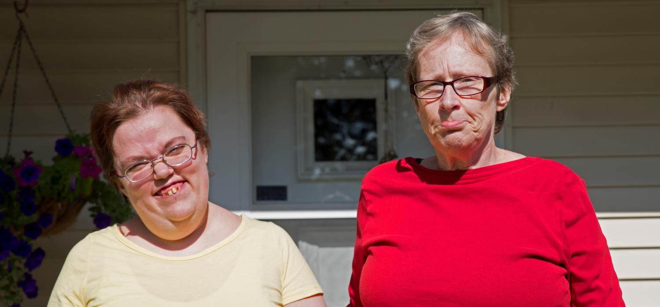
New CMS Rules for Providers
#4 - Visitors
You can have visitors at any time.
HCBS - A.C.T advocates creating transformation wwww.c-q-l.org/HCBS-ACT
Notes:
Carlos
Another big change is the fact that the house where you live is considered YOUR HOUSE. That means you can have visitors at YOUR HOUSE when you want! Now, you might be thinking to yourself, I like to go to bed early, I don’t want my housemate to have company late at night and keep me up!!! That is ok, what do you think you should do if you live with other people (you may have to prompt them to say “talk about it first” and decide with the people you live with when it is ok to have visitors. What if you live alone, can you have people over when you want? Yes you can! You know what? When I lived alone I had people visit me but they were only people I knew really well, I would not want to invite a stranger to visit me late at night when I was alone. It would be better to introduce them to some of your other friends first and maybe have them over when your friends are there too.

Slide 13
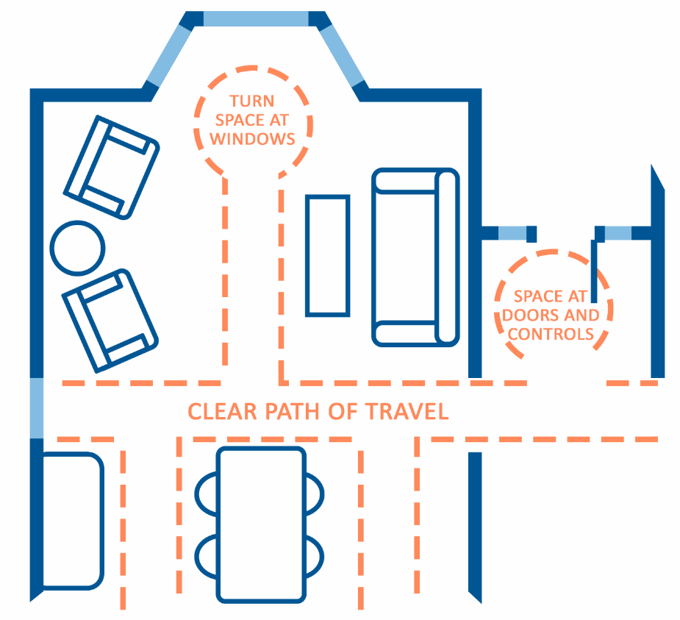
New CMS Rules for Providers
#5. Your Home is Physically Accessible
Your home meets your needs for physical accessibility
HCBS - A.C.T advocates creating transformation wwww.c-q-l.org/HCBS-ACT
Notes:
Carlos
Do you know that sometimes people live in houses and they cannot reach the sinks or take a bath by themselves? Sometimes the doors are too skinny, they cannot get through them! This rule means that you should be able to go anywhere you want to in your house. Sometimes people do not want to go into the basement, I know I don’t but if I need to, I should be able to even if it means I need help.

Slide 14
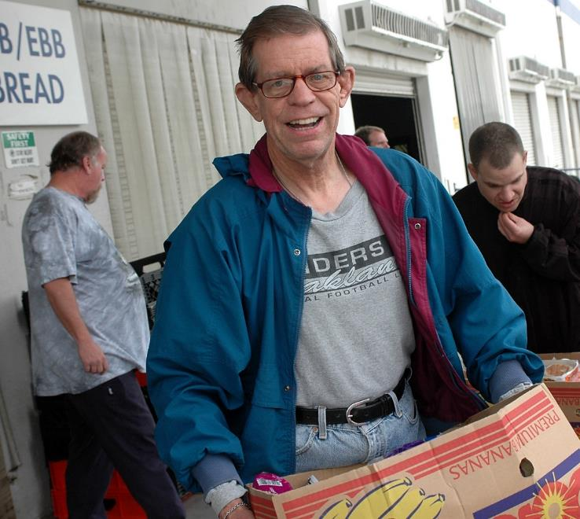
The New Rules
Temporary Restrictions
Sometimes the rules need to be modified
Notes:
Leanne
Optional Activity if Time Permits: So, lets talk about what this means for you but first, everyone stand up, turn to your neighbor, and tell your neighbor what your favorite color is. While the participants are doing this, turn to your co-teacher and tell them your favorite color. While everyone is standing ask them, what their neighbors favorite color is, you tell yours first. Anticipate a lot of talk and laughter try to make it fun. Perhaps have a giveaway, like pens, in all different colors and have people chose their neighbors favorite color and give it to them. This activity will give people time to stretch, interact and move around a bit. If it is loud and chaotic, which I hope it is, say in a loud voice, “If you can hear me clap once.” Typically people will clap more than once, thank them for clapping for you and move on.

Slide 15
Temporary Restrictions
If you need extra support
Sometimes people need extra support, like a “Behavior Program” or other “Restrictions”
When that happens, the provider has very strict rules they have to follow like:
Asking you if it is ok
Show that other stuff has not worked.
Show that it is temporary
HCBS - A.C.T advocates creating transformation wwww.c-q-l.org/HCBS-ACT
Notes:
Leanne
In the new rule CMS (what does CMS stand for?) made it possible for people who need extra support because they are sick or maybe they are sad a lot or mad a lot to get the extra help they need but only for how long they need it. With the new rule if someone can not do something they want to do (this is called a RESTRICTION) the agency has to do a lot of paperwork to show that they tried to do EVERYTHING POSSIBLE to keep from having to put a “RESTRICTION” in place. What is a RESTRICTION again?

Slide 16
The New Rules
For Planning
What the rules mean for Person-Centered
Planning mean for you!
Notes:
kathy

Slide 17
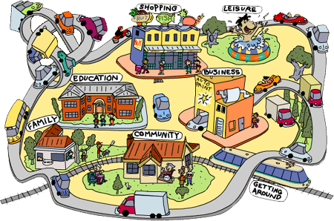
What Do You Want for Your Life?
HCBS - A.C.T advocates creating transformation wwww.c-q-l.org/HCBS-ACT
Notes:
Kathy
Polling Question
If You Had a millions dollars would you
A Take A Trip
Buy New Clothes
Have a Party
Something Else

Slide 18
What is Person Centered Planning?
Person-centered planning means that others should ask you about what is important to you and how your service provider can help you to get the things you want in life
HCBS - A.C.T advocates creating transformation wwww.c-q-l.org/HCBS-ACT
Notes:
.Kathy

Slide 19
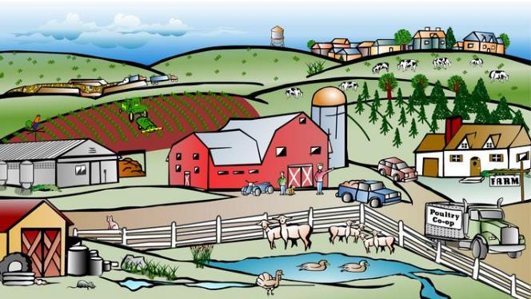
Does this Mean I Can Have Whatever I Want?
No, but it does mean that you can tell others what you want and they will try to help you to get the supports you need to live the kind of life that you want
HCBS - A.C.T advocates creating transformation wwww.c-q-l.org/HCBS-ACT
Notes:
Kathy

Slide 20
Who is Going to Help Me with Person Centered Planning?
Your Individual Service Coordinator is the main person who will help you. Others who can help you include your family, staff that work with you and anyone else you want to include
HCBS - A.C.T advocates creating transformation wwww.c-q-l.org/HCBS-ACT
Notes:
Kathy

Slide 21
How Does the Process Work?
Person-Centered Planning begins with Discovery and Assessment.
This is where the people helping you will ask you and others who know you well questions about what you like, what you want for your future and what services are important to you
HCBS - A.C.T advocates creating transformation wwww.c-q-l.org/HCBS-ACT
Notes:
Kathy

Slide 22
What Happens Next!
After learning more about you, your ISC will help you develop a Personal Plan that includes important information for those who will be helping you.
This can include a meeting where you can invite the people that you want to help you make your plan.
If you want to have a meeting, tell your ISC and he/she will help you plan it.
HCBS - A.C.T advocates creating transformation wwww.c-q-l.org/HCBS-ACT
Notes:
Kathy

Slide 23
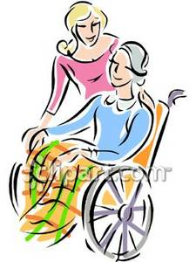
What Happens to My Personal Plan
Your ISC will help you to find an agency or people who can support you so that you can make the things included in your Personal Plan happen in your life.
HCBS - A.C.T advocates creating transformation wwww.c-q-l.org/HCBS-ACT
Notes:
Kathy

Slide 24
New CMS Regulations
Person-Centered Plan
You get to run your own staffing (ISP meeiting)
You can invite who you want!
You choose your goals
One of the great things about the new rule is that the person-centered plan must be in a format that you can understand!
You can have pictures
or
videos,
this is all about you!
HCBS - A.C.T advocates creating transformation wwww.c-q-l.org/HCBS-ACT
Notes:
Kathy

Slide 25
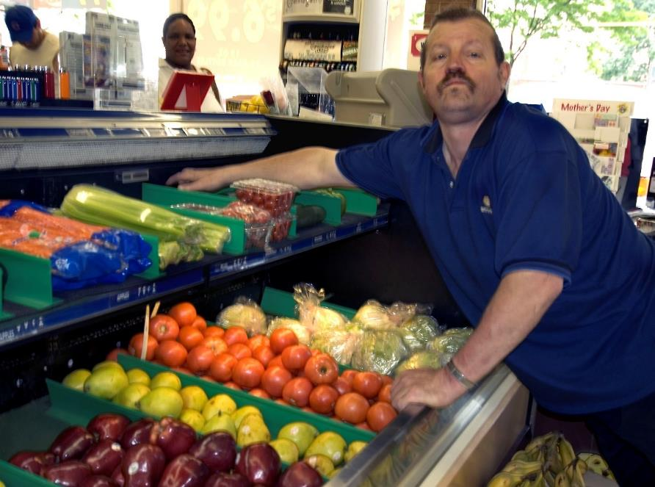
The New Rules
For Work And Day
What the rules mean for you during the day.
Notes:
Polling Question
Do you or your family member go to a workshop or day program during the day?
Yes or No

Slide 26
Day Programs and Workshops
They have rules too!
Many of the same requirements apply to where you work or what you do during the day:
Your day program needs to offer you a chance to do things outside of the day program building.
Like:
Shopping
Work
Hobbies
HCBS - A.C.T advocates creating transformation wwww.c-q-l.org/HCBS-ACT
Notes:
Leanne

Slide 27
Day Programs and Workshops
They have rules too!
Many of the same requirements apply to where you work or what you do during the day:
Your day program needs to offer you a chance to do things outside of the day program building.
Like:
Shopping
Work
Hobbies
HCBS - A.C.T advocates creating transformation wwww.c-q-l.org/HCBS-ACT
Notes:
Leanne

Slide 28
Day Programs and Workshops
Lots to think about
Is there a “Staff Bathroom”?
Do you have a secure place (like a locker) to put your stuff?
Are there rules that keep you from being able to
open doors, go to certain rooms or places, or
outside if you want.
Are there locks or gates to keep you from going certain places in the building.?
HCBS - A.C.T advocates creating transformation wwww.c-q-l.org/HCBS-ACT
Notes:
Leanne
Barriers can be actual or perceived…sometimes, a person doesn’t understand that a rule has changed or doesn’t apply

Slide 29
HCBS
it’s all about…
CHOICE!
Notes:
Questions

